Slide 1
Smart Home Automation and Security System
CEIS101 Final Course Project
CEIS101 WEEK 8
FISTON KADETWA BAHATI
Prof. ALIREZA KAVIANPOUR

Slide 2
Introduction
This project covers the fundamental concept of the IoT by integrating hardware (Circuit, Led, and many other components), software (Arduino) and network (Internet) into a whole system.
The objective of this project is to help me as a student, to practice what I have learned as theory for better understanding, and also familiarize with the tools that I will be using whenever I need to create a prototype of a prospective Automation System project.
The tools that I used in this project are Circuit Mega 2560 board, Leds, Resistor, Sensors, Buzzer, wires, Breadboard, Photoresistor, USB Cable, Arduino.

Slide 3
The following is the beginning of the project. This means you are going to see the tools, components and the code, I used during the process of making or creating an automation home system on the first project.

Slide 4
CEIS101
Module 2
Circuit Simulation in Tinkercad

Slide 5
Rubric
Activity | Requirement(s) | Points
Building circuit | Screenshot of completed circuit in Tinkercad | 20
Programming | Screenshot of code in Tinkercad | 20
IMPORTANT: You MUST include the title of your circuit design (shown under the Tinkercad logo) in the format of course number, session number, and your last name to receive credit.

Slide 6
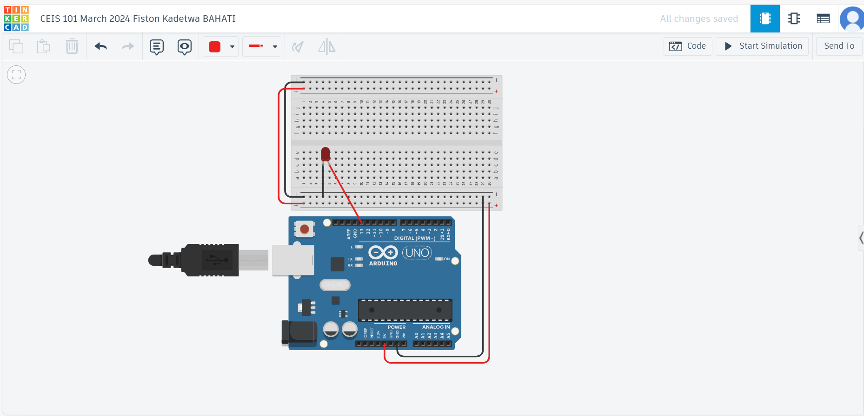
Circuit (screenshot)

Slide 7
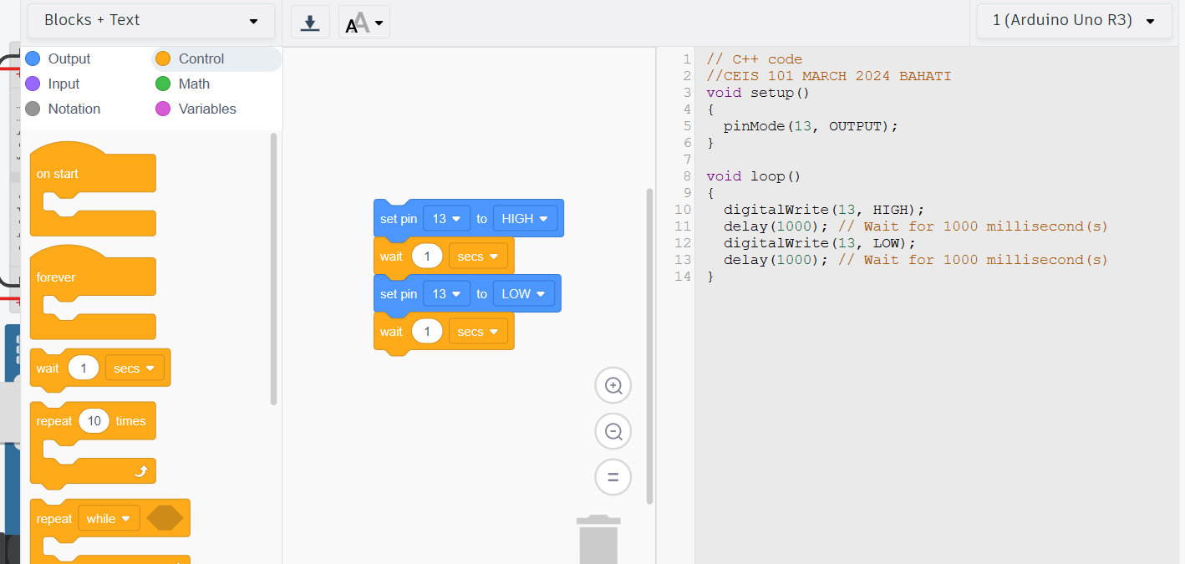
Code (screenshot)

Slide 8
The following is the continuation of the project but on this one, I only show the components used for the second project.
The Led which is in red color will be going on and off depending on the opening and closing of the door of our home.

Slide 9
CEIS101
Module 3
Inventory of Parts, Circuit Building, and Displaying Messages

Slide 10
Rubric
Activity | Requirement(s) | Points
Inventory of IoT Tech Core Kit | Picture of entire IoT kit | 5
Organization of components | Picture of required organization of components for course project | 15
Set up circuit | Picture of complete circuit with red LED on | 10
Run code | Screenshot of Serial Monitor showing your name and the messages that the LED is on/off | 10

Slide 11
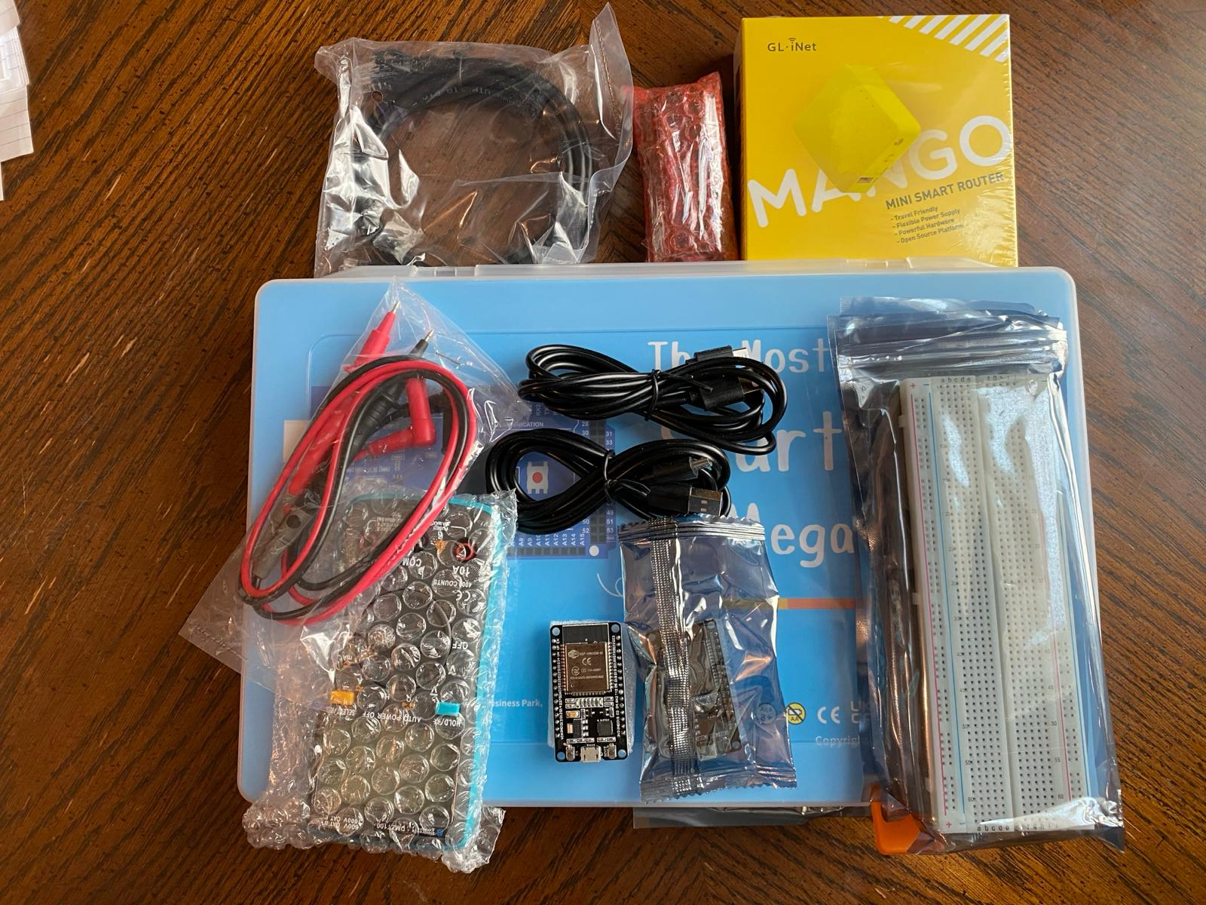
Inventory of IoT Kit (picture)
UCTRONICS Kit
ESP32 (2)
LCD Modules (2)
Breadboards (3)
Mini Router
Patch Cable
Digital Multi Meter
USB to Micro USB (2)

Slide 12
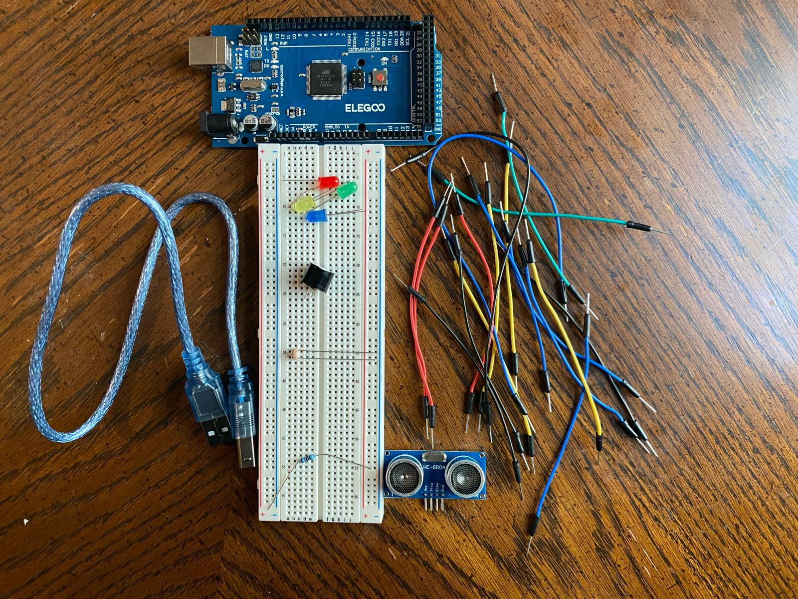
Organization of Project Components (picture)
Arduino Mega 2560
Breadboard
Resistor 10kΩ
LEDs
Ultrasonic Sensor
Active Buzzer
Photoresistor
Wires
USB Type B cable

Slide 13
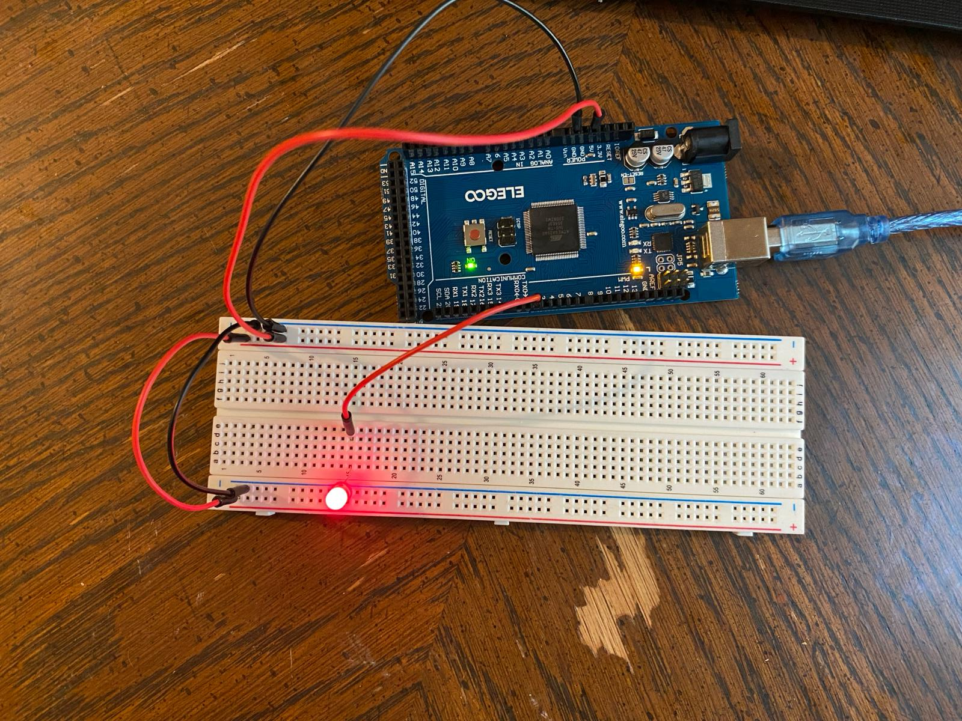
Circuit with red LED on (picture)

Slide 14
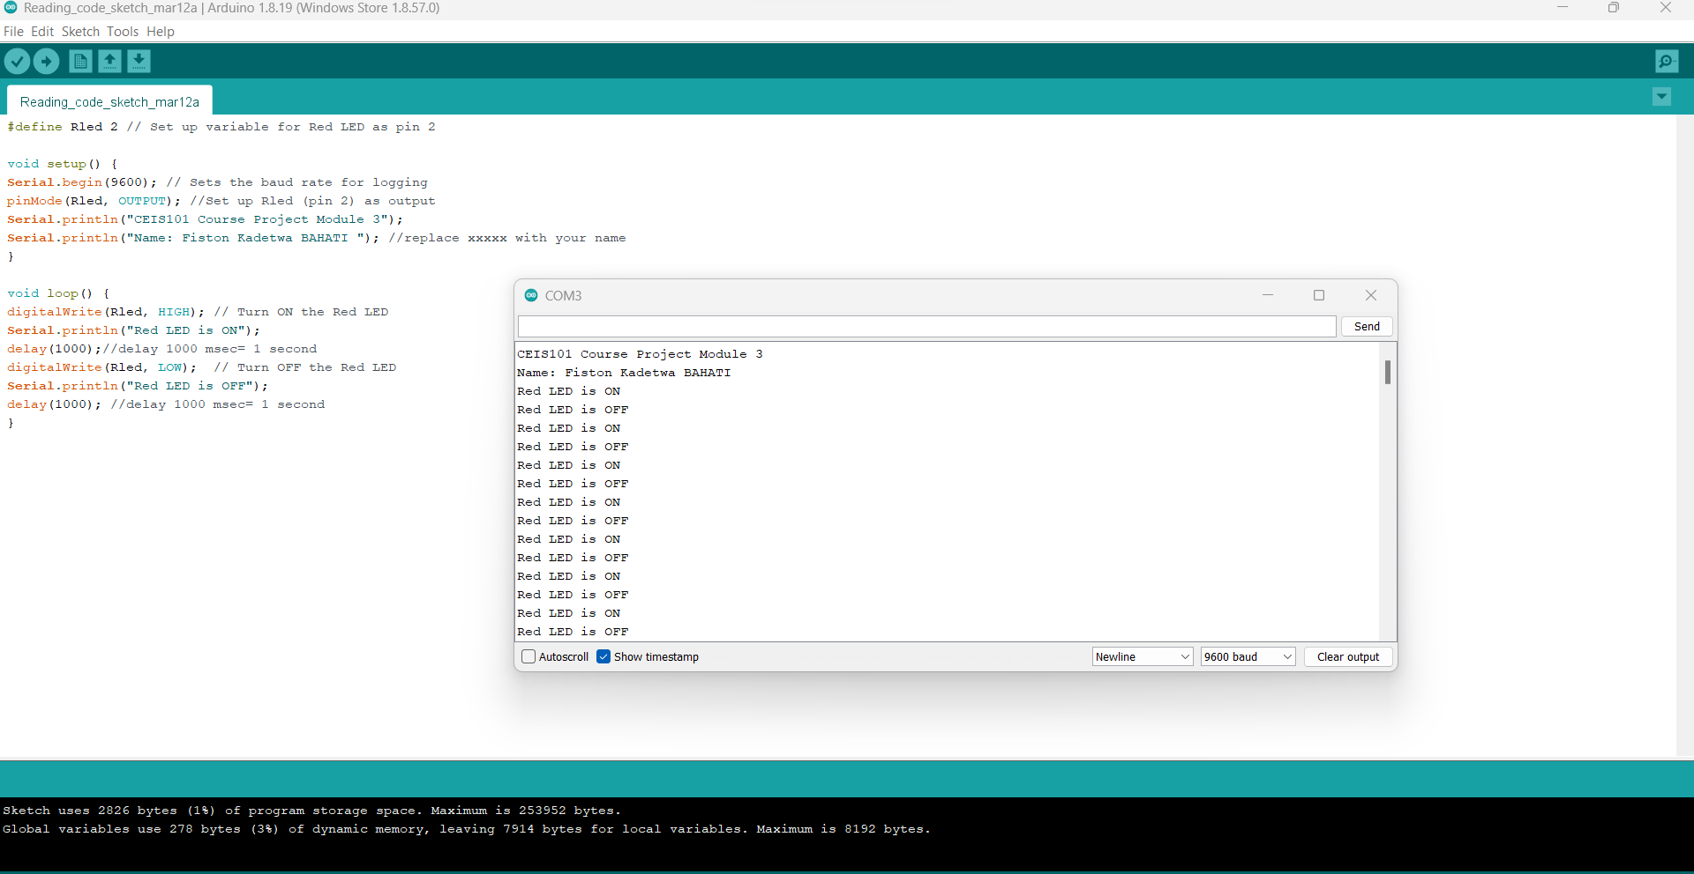
Serial Monitor (screenshot)

Slide 15
The following show the sensor I put, that will be making different Led on and off, depending on the presence or absence of an intruder.

Slide 16
CEIS101
Module 4
Adding Door Sensor to Smart Home System

Slide 17
Rubric
Activity | Requirement(s) | Points
Set up circuit | Picture of circuit with green LED on (door closed) | 10
Set up circuit | Picture of circuit with red and yellow LEDs on (door open) | 10
Upload code | Screenshot of code in Arduino IDE with your name shown | 10
Run code | Screenshot of serial monitor with your name and messages shown | 20

Slide 18
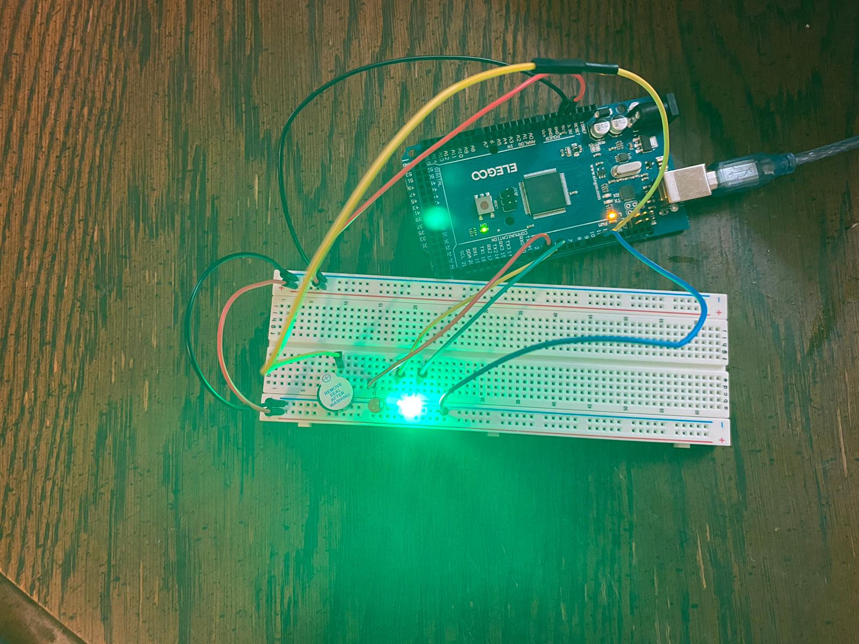
Circuit of door closed with Green LED ON (picture)

Slide 19
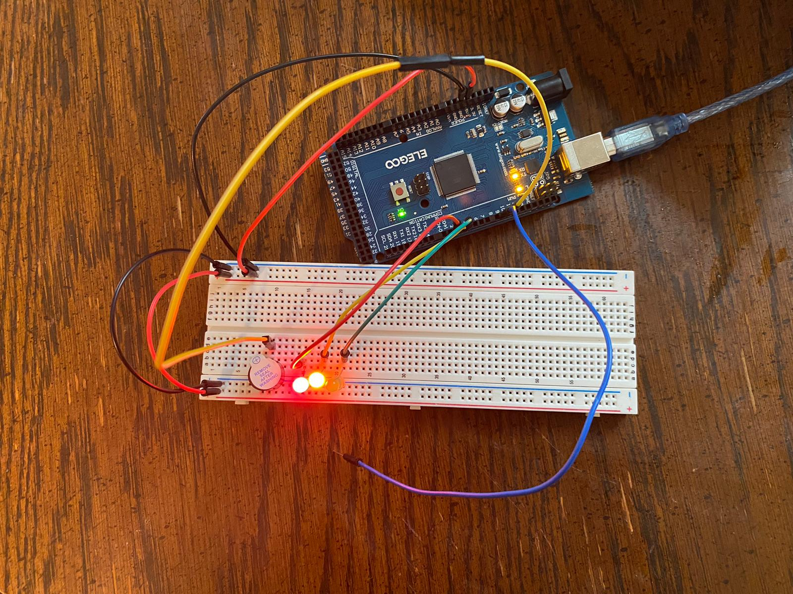
Circuit of door open with Green LED OFF (picture)

Slide 20
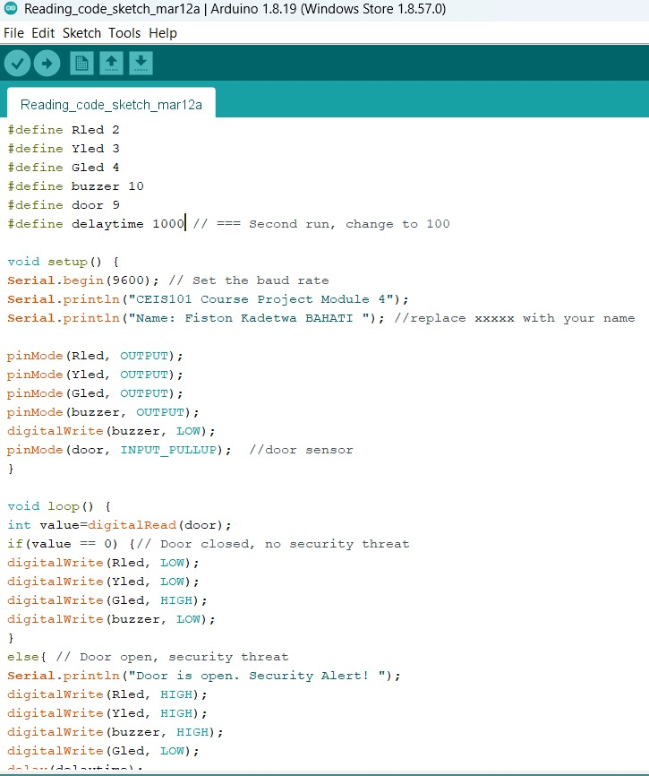
Arduino Code (screenshot)

Slide 21
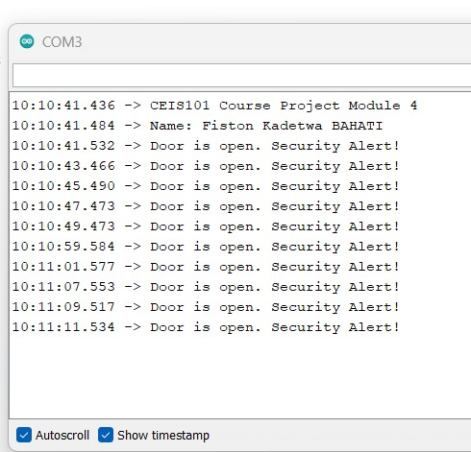
Serial Monitor (screenshot)

Slide 22
The following will show data analytics by making the led on and off depending on what was found near of far from the sensor.

Slide 23
CEIS101
Module 5
Adding Distance Sensor to Smart Home System
and Conducting Data Analysis

Slide 24
Rubric
Activity | Requirement(s) | Points
Set up circuit | Picture of circuit with green LED on | 5
Set up circuit | Picture of circuit with yellow LED on | 5
Set up circuit | Picture of circuit with red LED on | 5
Upload code | Screenshot of code in Arduino IDE with your name shown | 15
Analyze data | Excel plot of data generated by distance sensor | 20

Slide 25
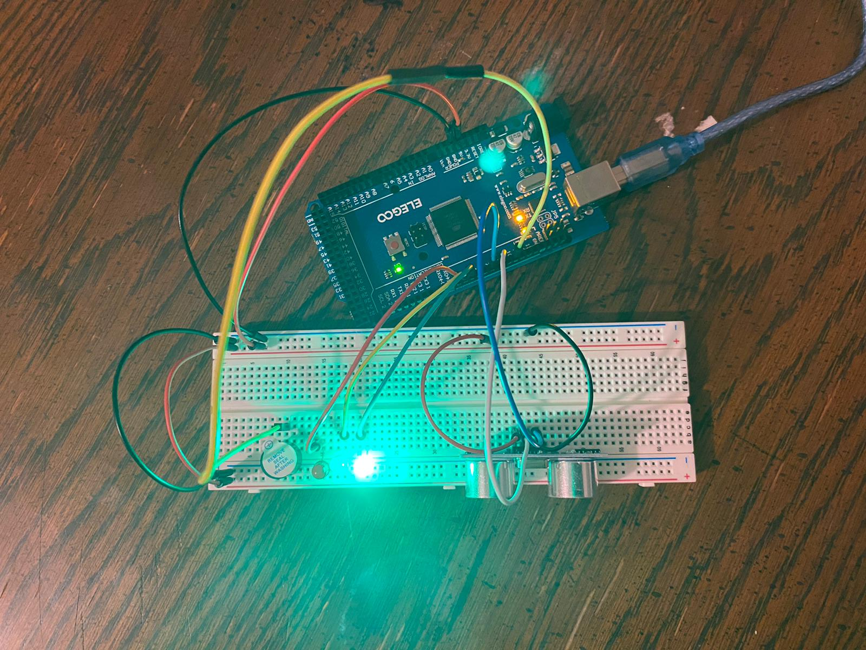
Circuit with green LED on (picture)

Slide 26
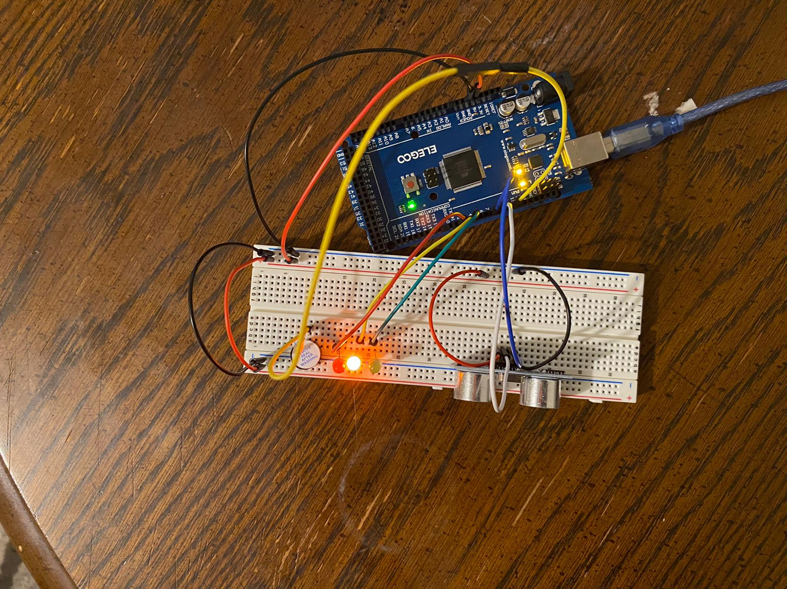
Circuit with yellow LED on (picture)

Slide 27
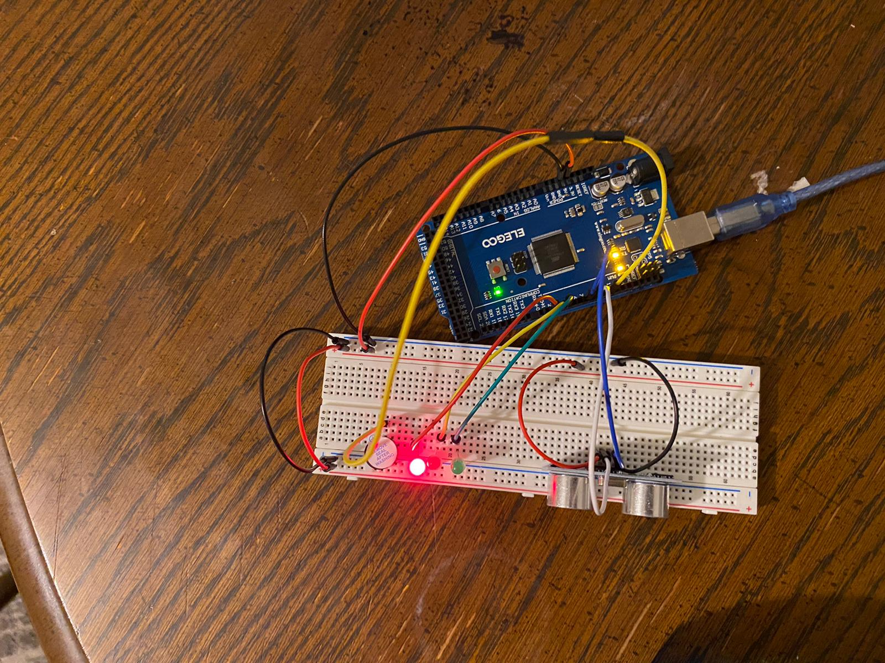
Circuit with red LED on (picture)

Slide 28
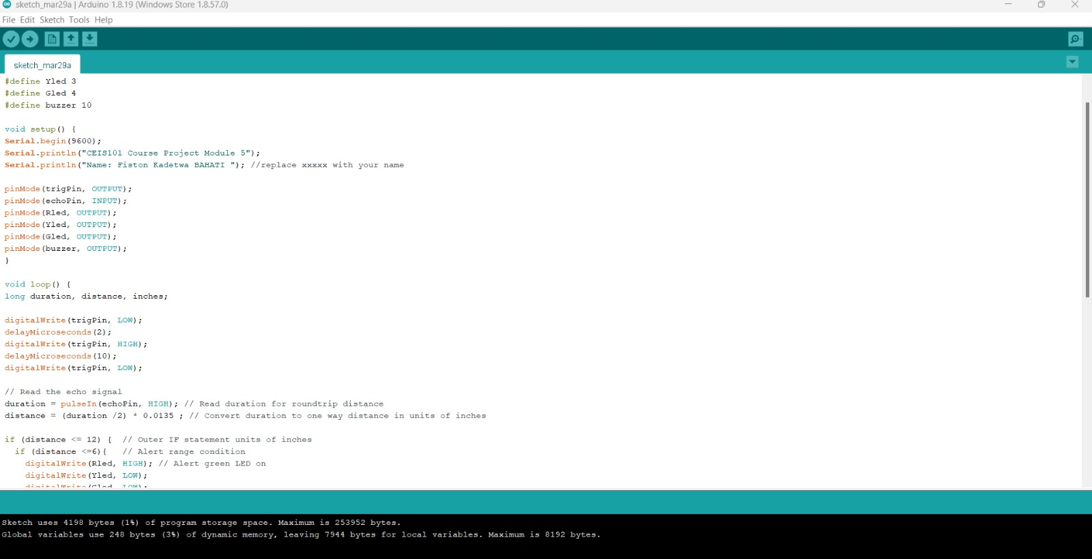
Arduino Code (screenshot)

Slide 29
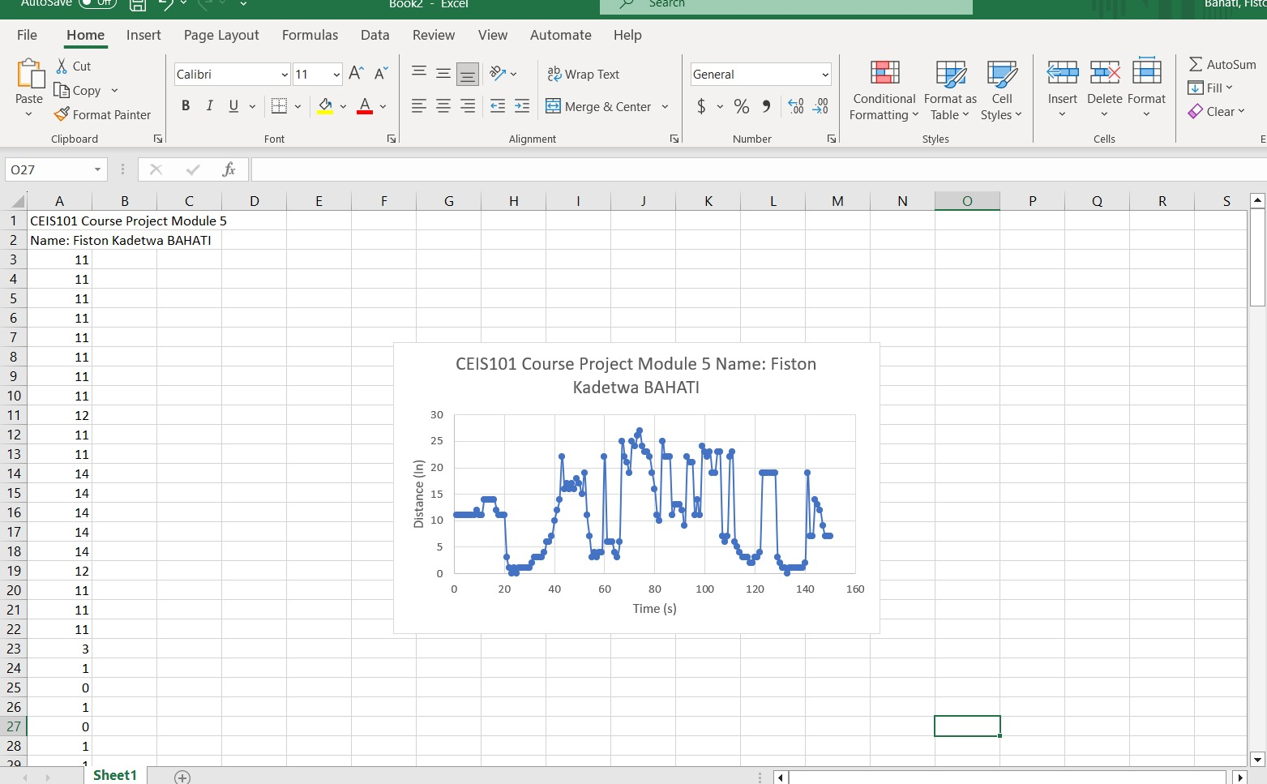
Plot of data (graph from Excel)

Slide 30
Finaly, the following is the last step in making this project. You will find the pictures showing different led on and off. If an intruder come close to the door, the light goes on and if moving away, it goes off.

Slide 31
CEIS101
Module 6
Adding Automated Light to Smart Home System

Slide 32
Rubric
Activity | Requirement(s) | Points
Set up circuit | Picture of complete circuit with automated LED off | 10
Set up circuit | Picture of complete circuit with automated LED on | 20
Upload code | Screenshot of code in Arduino IDE with your name shown | 10
Run code | Screenshot of Serial Monitor with your name and messages shown | 10

Slide 33
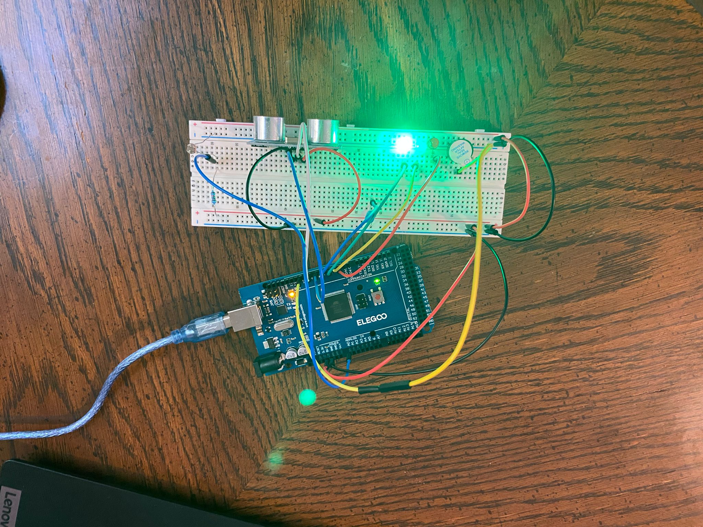
Circuit with automated LED off (picture)

Slide 34
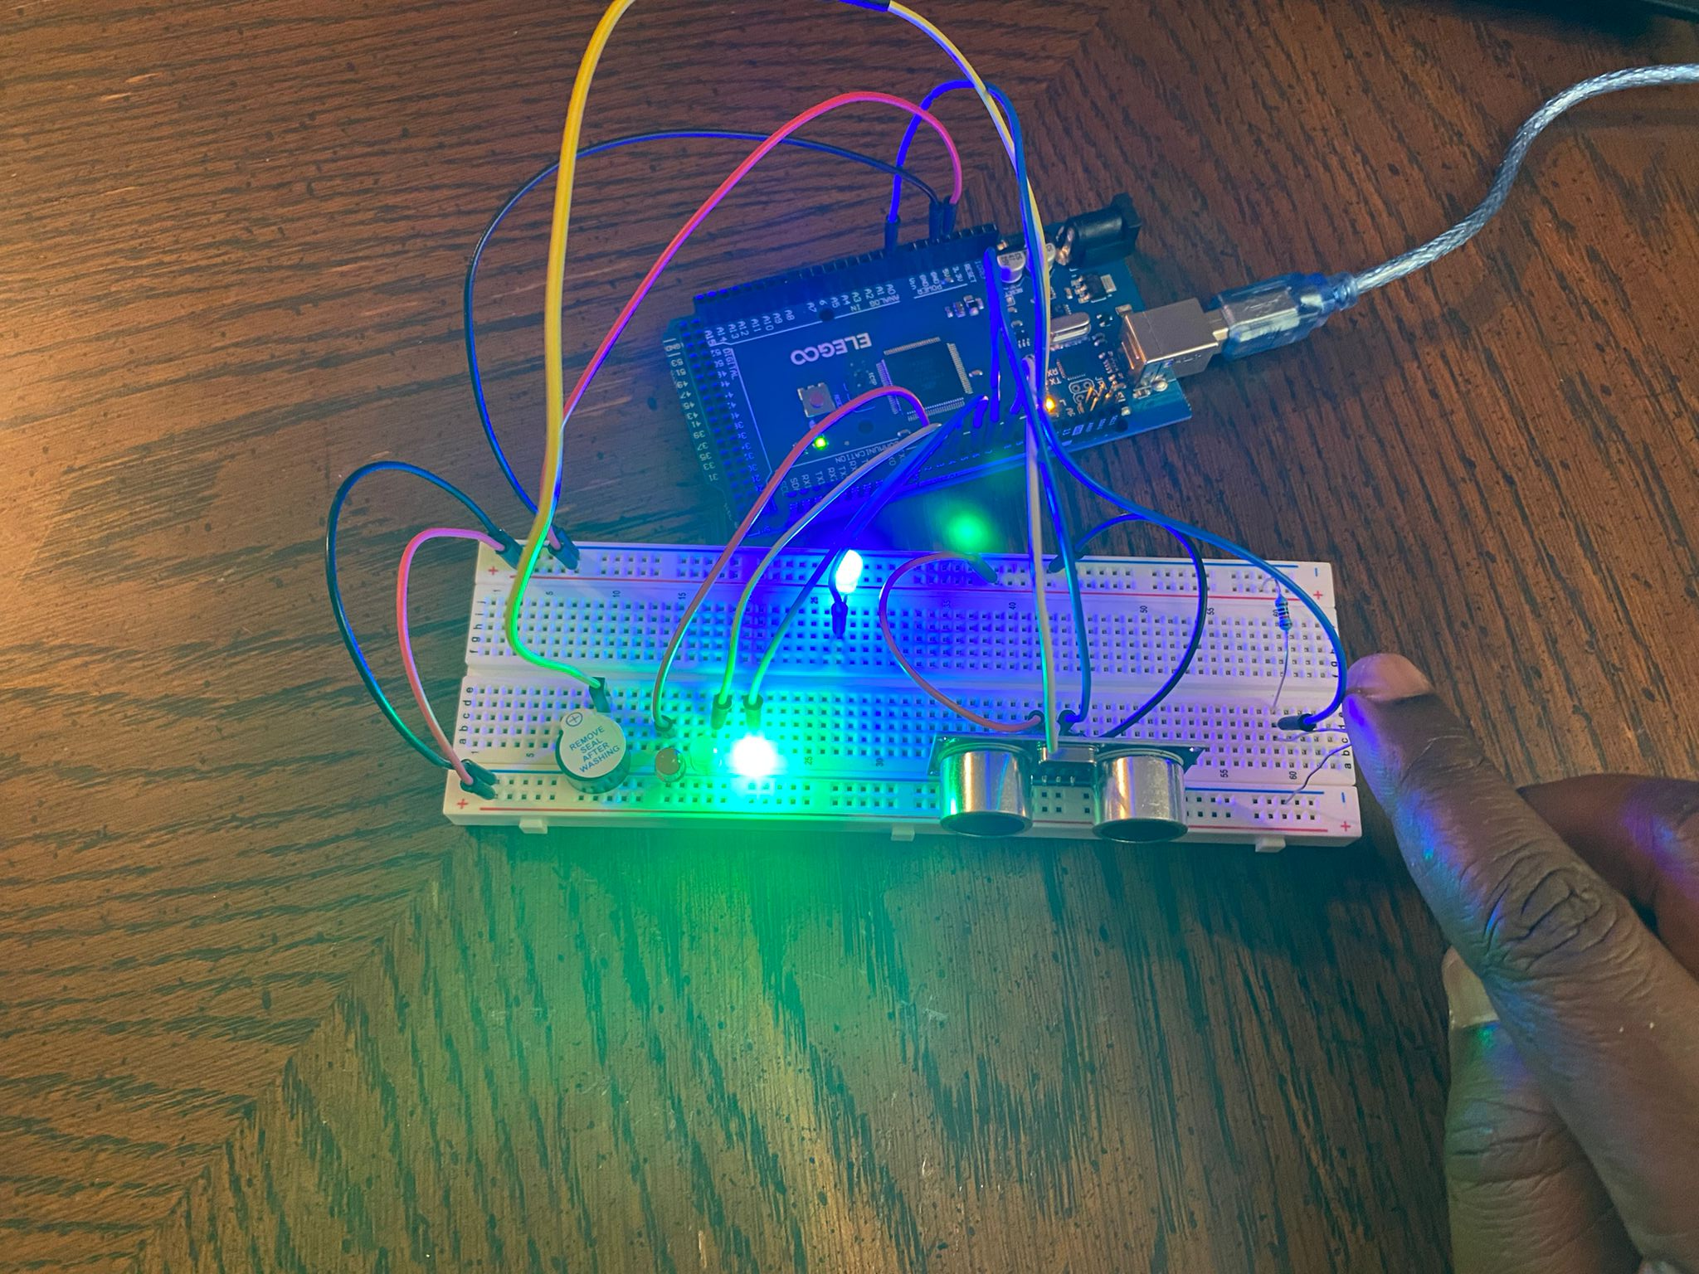
Circuit with automated LED on (picture)

Slide 35
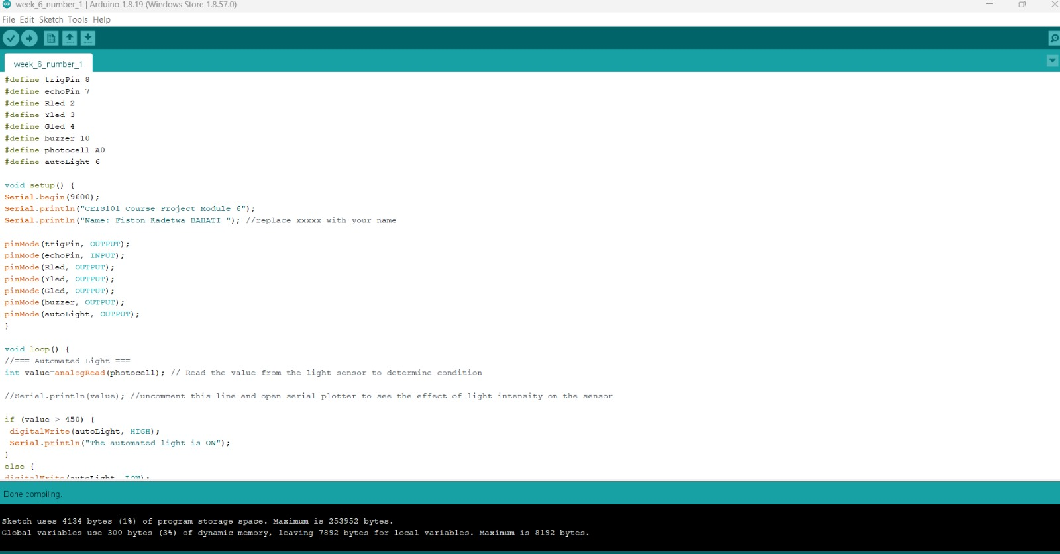
Arduino Code (screenshot)

Slide 36
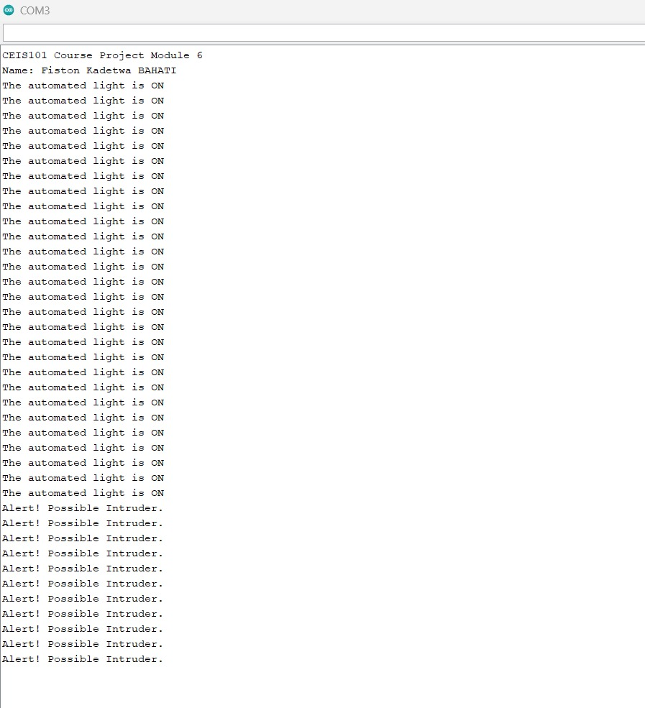
Serial Monitor (screenshot)

Slide 37
Challenges/Lessons Learned
What challenges did you face while working on the project?
In this project, I face different challenges, such as, failing to obtain a working outcome after the first try. Also, I struggled to find the corresponding port on the circuit, in which I was supposed to insert the wire.
How did you overcome these challenges?
I repeatedly watch the recording in the playback room, and I managed to understand how to overcome the challenges faced.
What lessons did you learn?
I learnt that, whenever I fail to get the result that I expect to get, I have to repeatedly try again and again, until I make it. Because It is just something that I will be missing, which make it not working. The fact that I will keep on trying, I will definitely find where I was making a mistake, and I will fix it on spot.

Slide 38
Career Skills
What skills did you develop to benefit your career?
I developed the following career skills: Collaboration, Detail-oriented, Project management.
What competencies will help you to gain the opportunities to advance your career?
The competencies I gained to advance my career: I am now able to make prototype, I am now able to understand the IoT, and connect different devices together and make them work using a software. I am able to make use of a code and edit it.

Slide 39
Conclusion
The world is changing to become a digital one, because almost everything is being digitalized. This helps to easy many processes and access to different types of data. Therefore, security is needed more than before , to protect our information by preventing, solving and preconizing prospective attacks and threats.
During this lesson, I managed to understand how things are connected to other things, people and machine. I also learned some of the attacks that can affect the system and jeopardize our data. I also learned different ways that can be used to prevent that and protect our informations.
With this opportunity, I would like to thank my professor Alireza and others for taking time to explain in detail this course and helping me understand how to start and complete this project.
I am also grateful to my classmates who shared their thoughts and research with regard this course, from which I benefited considerably. And finally, I would like to also convey my gratitude to DeVry University for accepting me as student and for providing me with the knowledge on the IoT.

Slide 40
References
I got this from different classes I attended and participated for 8 weeks. My class is my reference on this project and course.

Slide 41
Submit your final project through the Assignments page,
Projects | Wix.com

